Slide 1

Introduction to Cognition

Slide 2
Overview
Search Engine Optimisation (SEO)
Introduction to cognition

Slide 3
Search Engine Optimisation (SEO)
SEO is a marketing discipline focused on growing visibility in search engine results. SEO encompasses both the technical and creative elements required to improve rankings, drive traffic, and increase awareness in search engines.
https://moz.com/beginners-guide-to-seo

Slide 4
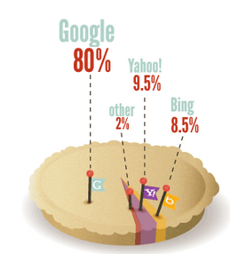
Search Engine Optimisation (SEO)
https://moz.com/search-ranking-factors/survey

Slide 5
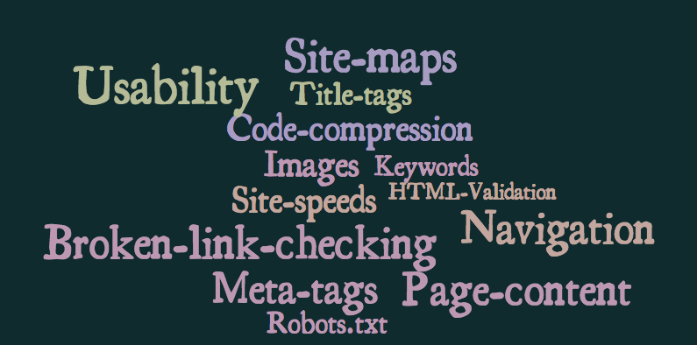
SEO

Slide 6

Human Considerations
Cognition is what goes on in our heads when we carry out everyday activities
Human Considerations

Slide 7
Cognitive Frameworks
Cognitive frameworks help us to understand how users become familiar with a system
2 common frameworks are:
  Mental Models
  Metaphors
Human Considerations

Slide 8
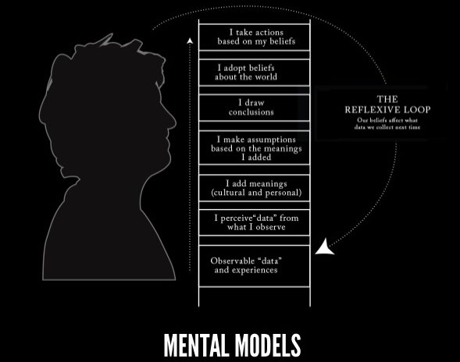
Cognitive Frameworks - Mental Models
Human Considerations

Slide 9
Cognitive Frameworks - Mental Models
Users develop an understanding of a system through learning & using it
People make inferences using mental models of how to carry out tasks
Human Considerations

Slide 10
Cognitive Frameworks - Mental Models
A mental model is based on belief not facts.
Individual users each have their own mental models.
Mental models are in flux.
Human Considerations

Slide 11
Cognitive Frameworks - Mental Models
Mental models can be described as “internal constructions of some aspect of the external world enabling predictions to be made”
People sometimes uses erroneous mental models
Human Considerations

Slide 12
Cognitive Frameworks - Mental Models
Example:
You arrive home on a cold winter’s night to a cold house. How do you get the house to warm up as quickly as possible?
Set the thermostat to be at its highest ?
Set the thermostat to the desired temperature?
Typically, people select to set the heat to its highest setting to “get it to heat up as fast as possible”
However, the thermostat will not heat any faster at a higher setting - erroneous mental model
Human Considerations

Slide 13
Cognitive Frameworks - Mental Models
Other Incorrect Mental Models:
Pressing the button at pedestrian lights – more presses, lights will change faster..
Cursor freezes on the computer – press various different types of keys…
Hit the TV to make it work..
Human Considerations

Slide 14
Cognitive Frameworks - Mental Models
Mixed up mental models in IT systems:
Operating System windows vs. browser windows
A window vs. and application
Icons vs. application
Browse commands vs. native commands in a web-based app
Local vs. remote info
Different passwords and log-in options
Human Considerations

Slide 15
Cognitive Frameworks - Mental Models
What is your mental model of how you buy an item from an ecommerce website works?
What is your mental model of how a hotel website works?
Human Considerations

Slide 16
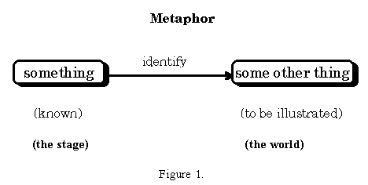
Cognitive Frameworks - Metaphors
Metaphor is a figure of speech in which an expression is used to refer to something that it does not literally denote in order to suggest a similarity
Human Considerations

Slide 17
Cognitive Frameworks - Metaphors
  Most prevalent metaphor – “the mind is an information processor”
  Information enters and exits the mind through a series of processing steps
Human Considerations

Slide 18
Exercise 1:
Look at your mobile phone:
What are the underlying metaphors, if any?
Are there any other obvious metaphors?
Where are some of the points the metaphors fail?
Did the metaphors help you discover how the program works? Did they help you remember the functions of the controls?

Slide 19
Cognitive Frameworks - Metaphors
Metaphors are implemented using:
Skeuomorphism:
Refers to a design principle in which design cues are taken from the physical world.
This term is most frequently applied to user interfaces (UIs), where much of the design has traditionally aimed to recall the real world - such as the use of folder and files images for computer filing systems, or a letter symbol for email - probably to make computers feel more familiar to users.

Slide 20



Cognitive Frameworks - Metaphors

Slide 21

Cognitive Frameworks - Metaphors
The hamburger icon
https://www.sitepoint.com/what-if-an-icon-choice-ruined-your-work/?utm_content=buffereebc1&utm_medium=social&utm_source=twitter.com&utm_campaign=buffer

Slide 22
Cognitive Frameworks - Metaphors
When using icons, remember:
Confidence in interface leads to further use.
Keep it simple.
Test the icons for recognisability.
Use the 5-second rule for icons. If it takes you longer than 5 seconds to think of the image, it probably isn’t the best way to communicate that idea/action.
Give control to your users.
Build consistency for a better experience and branding awareness.
Don’t forget that you are designing an interface for your users, not yourself.

Slide 23
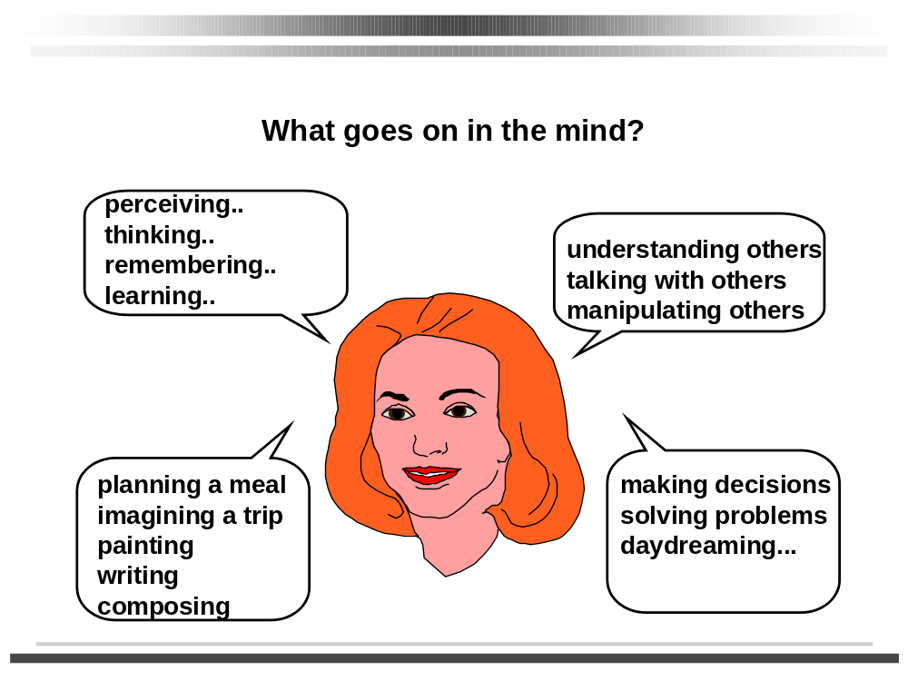
Cognitive Processes
Human Considerations

Slide 24
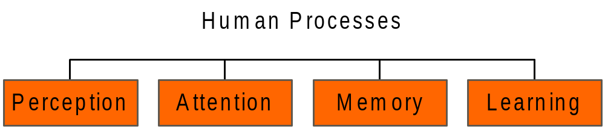
Cognitive Processes
Variety of cognitive attributes have an important influence on screen design
Human Considerations

Slide 25
Terms of Reference
    Preece, J. et al. (2002) Interaction Design
    Shneiderman, B. & Plaisant, C. (2005) Designing the User Interface
    Benyon, D. et al (2005) Designing Interactive Systems
    Wyeth, P. & Purchase, H. (2003) Using Developmental Theories to Inform the Design of Technology for Children
    Hawthorn, D. (2003) How Universal is Good Design for Older Users
    Nielsen, J. (1995) Advances in Human-Computer Interaction
    http://www.slideshare.net/willevans/good-design-is-honest-the-cognitive-science-of-user-experience-design
References

